Slide 1
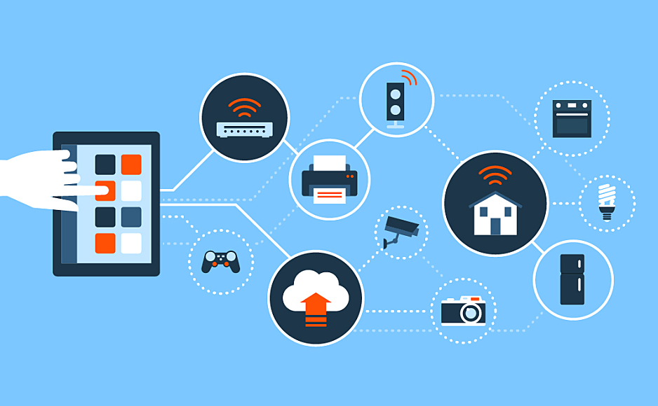
Network Security

Slide 2
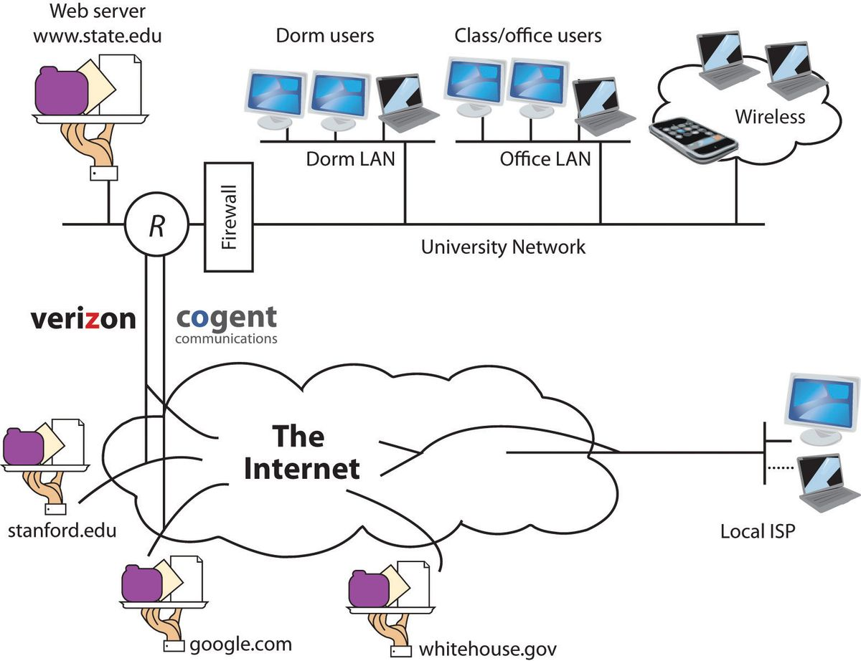
Network Exterior

Slide 3
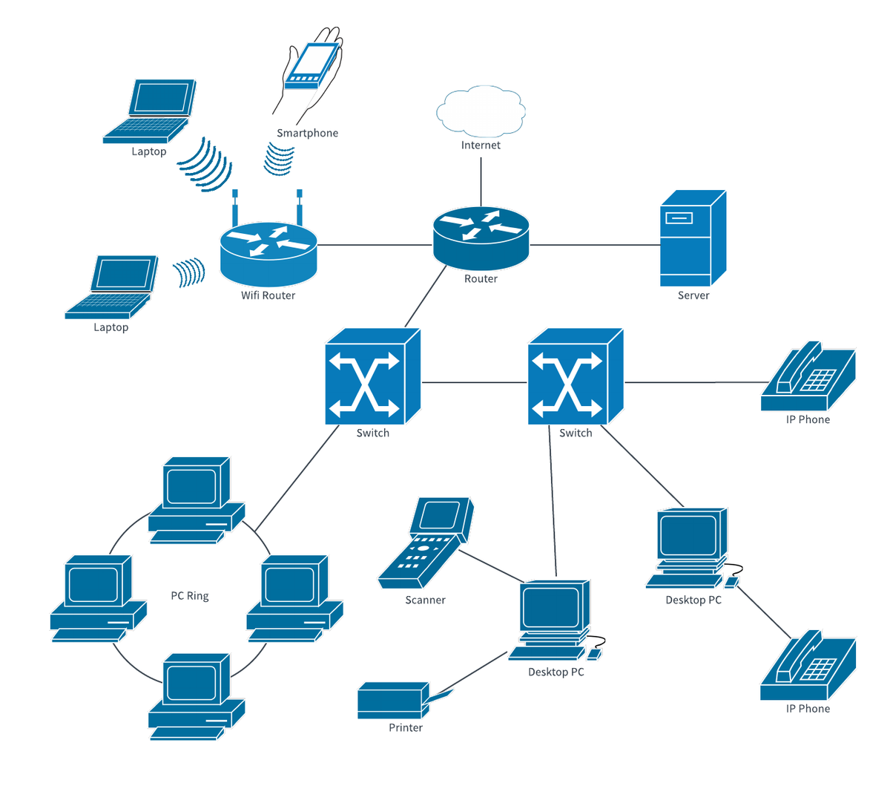
Network INterior

Slide 4
Perimeter Defense
Typical defenses
Firewalls: Placed at terminal ends of every network segment
Specialized application proxies
Demilitarized zones (DMZ)
Perimeter or screened network
Noncritical yet secure region generally designed at periphery of internal and external networks
Typical location for resources that must be accessed from both Internet and internal network, i.e. Web servers and FTP servers

Slide 5
Dfense-In-Depth
Advanced Threat Protection (ATP)
Intrusion Detection/Prevention (IDS/IPS)
Web Security
Email Security
Data Loss Prevention (DLP)
Firewalls
Security Event and Incident Monitoring (SEIM)

Slide 6
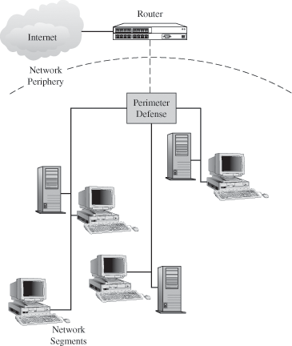
Perimeter Defense (II)

Slide 7
Border Security
Border security: Implementing security for different network segments
Devices used for regulation and control
Routers
Switches
Bridges
Multi-homed gateways

Slide 8
Typical Network Segments
Public networks
Allow access to everyone, e.g. Internet
Semi-private networks
Sit between public and private networks
Typically exclusive subnets of large public networks
Private networks
Organizational networks handling confidential and proprietary data
May have exclusive addressing and protocols

Slide 9
Firewalls
Firewalls
Used to secure connections to unsecured network such as Internet
Provide defense against:
Poor authentication
Weak software
Spoofing
Scanners and crackers

Slide 10
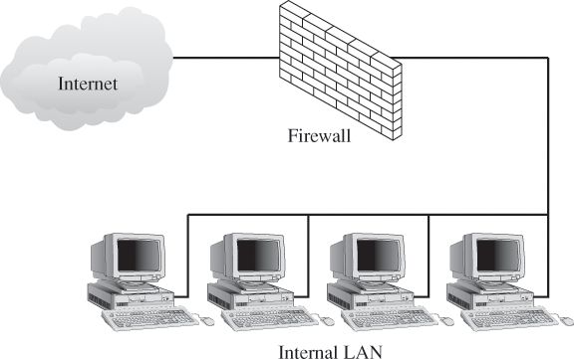
Firewalls

Slide 11
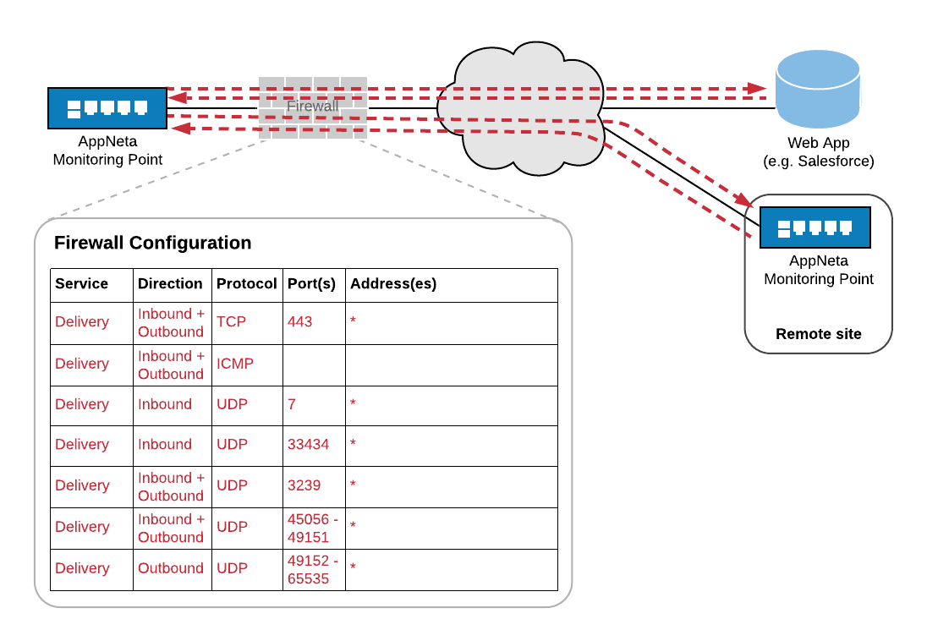

Slide 12
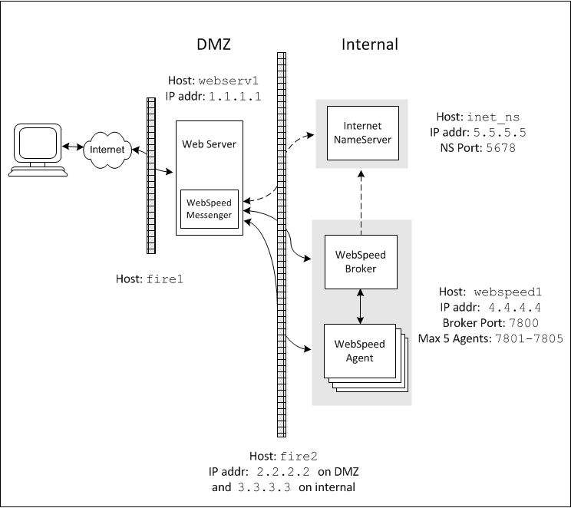
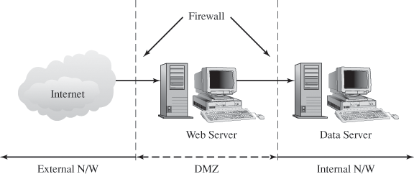
Web Server in a DMZ

Slide 13
Firewalls
Packet-filtering firewalls
Use filters (rules) to determine which packets should be allowed, based on metrics such as: IP addresses, contained protocols
Stateful packet-filtering (inspection) firewalls
Connection information maintained in state tables
Validated packets forwarded based on rule set defined for particular connection
Application proxy firewalls
Shielding and filtering mechanism between public and private networks, allowing complete shielding of applications

Slide 14
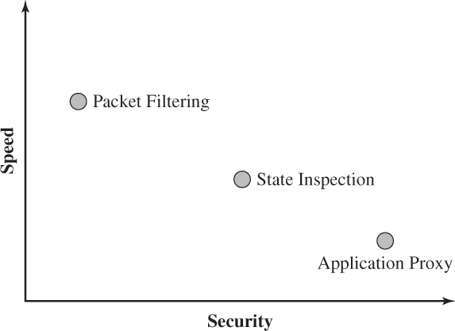
Comparison of Firewall Technologies

Slide 15
Network Address Translation
Network Address Translation (NAT)
Service that translates internal, private addresses into routable addresses on public network
Translation table: Allows single public IP address to be mapped to multiple private IP address
Outside packets require public address and port number to reach particular host on private network

Slide 16
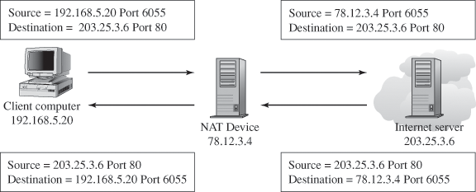
NAT Methodology

Slide 17
Types of Attacks
Packet sniffers
Eavesdropping on network data
Denial of Service (DoS)
Misdirecting packets via router, switch or hub
Overwhelming devices with large numbers of packets

Slide 18
TCP Session Hijacking
Normal TCP/IP session
Client initiates 3-way handshake with server using SYN, ACK messages
TCP session hijacking
Attacker impersonates valid client
Can be run in Unix environment, where attacker spoofs messages from trusted host
Can be run in environment where authentication not required

Slide 19
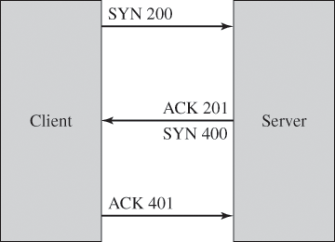
TCP/IP Session Initiation

Slide 20
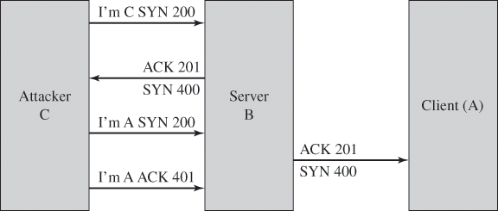
TCP Session Hijacking Attack

Slide 21
TCP SYN Flooding Attacks
Half-open connections
In SYN_RECV state, computers limit number of connections that haven’t completed handshake
TCP SYN flooding attack
Attacker initiates large number of open requests (SYN packets) without completing handshake, so B reaches limit and cannot respond to more requests

Slide 22
Considerations for a Secure Infrastructure
Decide what network traffic needs securing
Identify compatibility issues of operating systems installed and applications running on them
Ensure hardware is secure
Determine methods to use to secure data that will be transmitted over network

Slide 23
Securely Transmitting Data
When data needs to be securely transmitted over network, to mitigate risk of attack:
Ensure data will not be read by unauthorized individuals between you and source
Verify/authenticate identity of people, computers sending packets
Verify data will not be tampered with during transit

Slide 24
Defining Network Perimeters
One way to secure network
Isolate segments that have secure data transmission requirements
You can segment network at:
Layer 3: Using routers, subnets
Layer 2: Using switches, VLANs
Network perimeter: Any point connecting internal network to external network
Screened subnets
DMZs
WAPs
VPN connections

Slide 25
Isolating Insecure Networks with Subnets
Screened subnet
Uses routers, firewalls to screen traffic
Three main configurations
Bastion host
Three-pronged configuration
Back-to-back configuration

Slide 26
Bastion Host
Bastion host
Acts as sole connection to Internet
Two network adapters for:
Internet network
External network
Can be single point of failure

Slide 27
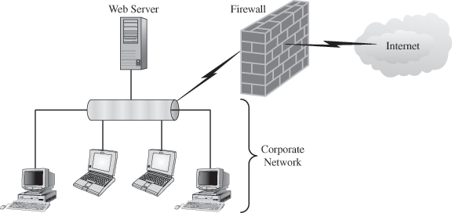
Bastion Host

Slide 28
Three-Pronged Configuration
Firewall system has three network adapters, for:
Internal network
External/public network
Screened subnet
Allows hosts from both internal and external networks to access resources on screened subnet

Slide 29
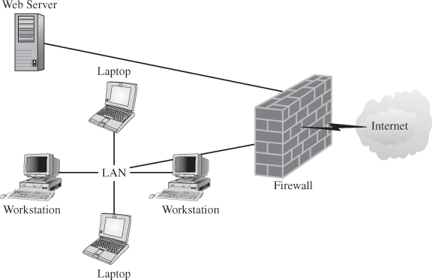
Three-Pronged Configuration

Slide 30
Back-to-Back Configuration
Screen subnet placed between two firewalls
Between subnet and Internet
Between subnet and internal network
Most secure configuration

Slide 31
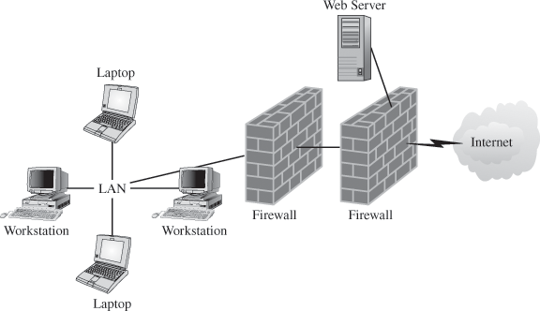
Back-to-Back Configuration

Slide 32
Switches and VLANs
Virtual LANs (VLANs)
Created with switches
Tag (VLAN ID) associates hosts in VLAN
Limits broadcast domain:
All communication occurs through router
Subject to VLAN hopping
Attackers bypass VLAN boundary by modifying VLAN ID

Slide 33
Using IP Addresses and IP Packet Filtering
Filtering: Added layer of protection
IP address filtering
Filtering traffic based on client’s IP address
Two main options:
Enabling all traffic except for IP address list
Allow only IP addresses listed
IP packet filtering
Filter defined by protocols or ports
Prevents specific packets from reaching destined ports

Slide 34
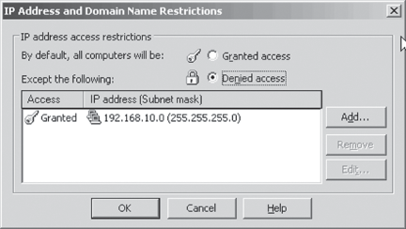
IP Address Filtering in IIS

Slide 35
Data Transmission Protection Protocols
Protocols for protecting data when transmitted, by:
Authenticating
Encrypting
Ensuring integrity of data
Data transmission protection protocols include:
SSL and TLS
IPSec
SMB Signing
SSH

Slide 36
SSL and TLS
Provide session encryption and integrity for client-server or server-server traffic
Can provide client authentication through X.509 certificates
SSL: Two components
SSL Handshake protocol: Sets up cryptographic parameters
SSL Record layer: Provides encryption services
TLS: Enhancement of SSL

Slide 37
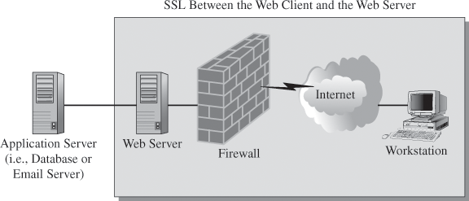
SSL on a Network

Slide 38
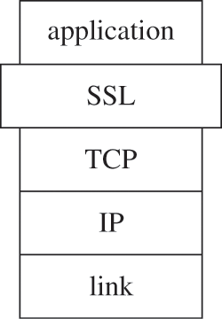
The SSL Security Layer

Slide 39
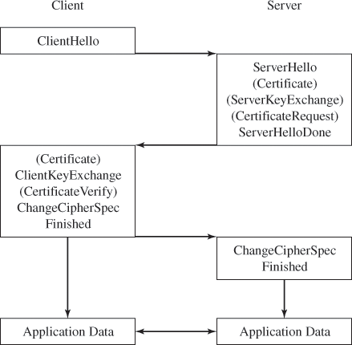
SSL Handshake Protocol

Slide 40
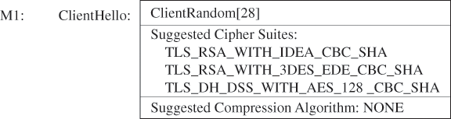
ClientHello Message

Slide 41
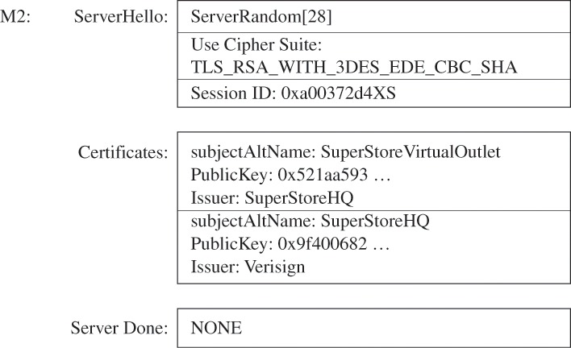
ServerHello Message

Slide 42
IP Security (IPSec)
Optional with IPv4, required with IPv6
Used to secure traffic on LAN or VPN
Can be configured for:
Confidentiality
Authentication
Data integrity
Packet filtering
Protection against data replay attacks
Can be configured to use multiple security algorithm options

Slide 43
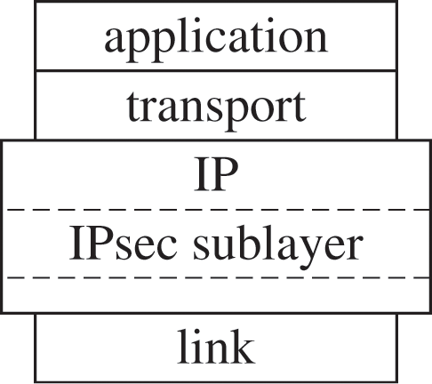
IPSec on the Stack

Slide 44
IP Security (IPSec)
Two major security mechanisms:
Authentication header
Protects integrity, authenticity only
Encapsulating security payload (ESP)
Can provide:
Confidentiality
Data origin authenticity
Data integrity
Some replay protection
Limited traffic flow confidentiality

Slide 45
ESP
ESP packet
Header
Security Parameters Index (SPI)
Sequence number
Payload data
Trailer
Padding
Pad length
Next header
Authentication data

Slide 46
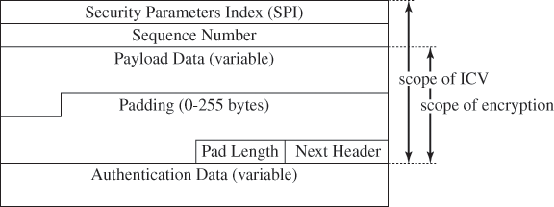
ESP packet

Slide 47
ESP
ESP can operate in one of two modes
Transport mode
Encapsulates upper-layer protocol frame
Provides end-to-end protection
Tunnel mode
Original IP datagram encapsulated within outer IP datagram (IP within IP)
Provides gateway-to-gateway security

Slide 48
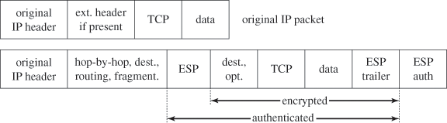
Transport Mode

Slide 49
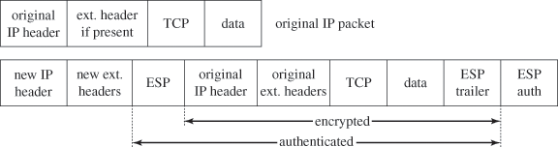
Tunnel Mode

Slide 50
Security Associations (SA)
Stores cryptographic data
Algorithm, key, key lifetimes
Enables system to generate, decrypt, verify ESP packets
Created in pairs
Two SAs required for bidirectional communication between two hosts
Uniquely identified by:
SPI (in AH and ESP headers)
Destination IP address
Security protocol (AH, ESP) identifier

Slide 51
Internet Key Exchange Protocol (IKE/IKEv2)
Alternative to manually creating SAs
Provides for:
Entity authentication
Establishment of fresh shared secret, used to derive additional keys
Secure negotiation of all cryptographic algorithms
Authentication method, key exchange method, encryption algorithms, hash algorithms

Slide 52
Configuring IPSec on a Windows Network
Windows built-in, basic IPSec policies
Client (Respond Only)
Server (Request Security)
Server (Require Security)
Can create custom IPSec policy with rules for:
Filters, filter actions
Authentication (Kerberos, PKI, or pre-shared key)
Mode (tunnel or transport)
Network interface policy applies to
Means for exchanging keys over Internet using IKE

Slide 53
Secure Shell
Secure Shell (SSH, SSHv2)
Provides security for remote login programs (Telnet, FTP)
Uses public key encryption schemes to provide data confidentiality and authentication
Features include:
Replaces conventional remote login programs (sftp, sshd)
Supports multiple encryption algorithms
High-end security algorithms to detect identity spoofing
Authentication through RSA or DSA key pairs

Slide 54
Server Message Block Signing
Server Message Block (SMB) protocol
Used when accessing files over network share on Windows server, by default not secure
SMB signing: Adds keyed hash to each SMB packet
Guards against man-in-middle, replay, session hijacking attacks
Does not provide confidentiality
Enabled by default on Windows 2000 Server and newer
If not enabled on client, client cannot access server with enabled SMB signing

Slide 55
Honeypots
Honeypots are systems that are provided to entice attacks
Value lies in unauthorized usage
No production value
Gather information about attackers
Ability to catch new forms of attacks
More information:
http://project.honeynet.org/index.html

Slide 56
Honeypot Types
Low-interaction
Emulates services, applications, and OS’s.
Low risk and easy to deploy/maintain, but capture limited information.
High-interaction
Real services, applications, and OS’s
Capture extensive information, but high risk and time intensive to maintain.

Slide 57
Honeynets
High-interaction honeypot designed to capture in-depth information.
Information has different value to different organizations.
Its an architecture you populate with live systems, not a product or software.
Any traffic entering or leaving is suspect.

Slide 58
Honeynets
A highly controlled network where every packet entering or leaving is monitored, captured, and analyzed.
Data Control
Data Capture
Data Analysis

Slide 59
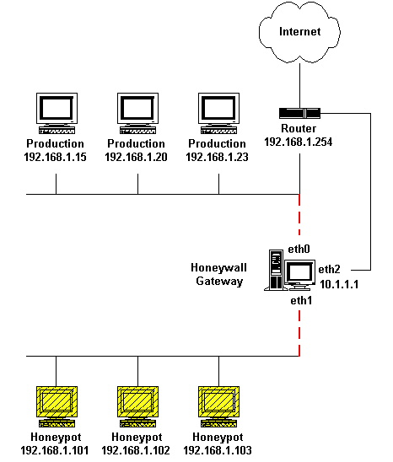
Honeynets – Example

